Slide 1
Digital Terrain Model Generation from GPS Point Cloud
Shuai He, Conan Jennings

Slide 2
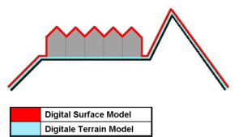
What is a Digital Terrain Model (DTM)?
Digital Terrain Model
Contains only terrain features
Digital Surface Model
Contains surface heights
Digital Elevation Model
Often synonymous with DTM
Elevation rendering

Slide 3
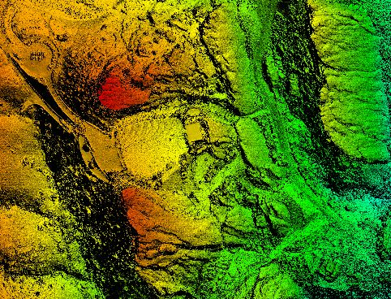
Applications of HD DTM/DEM
Flight planning and simulation
3D modeling for aerial/satellite photography
Engineering and Infrastructure design
Precision farming and forestry
Intelligent transportation system

Slide 4
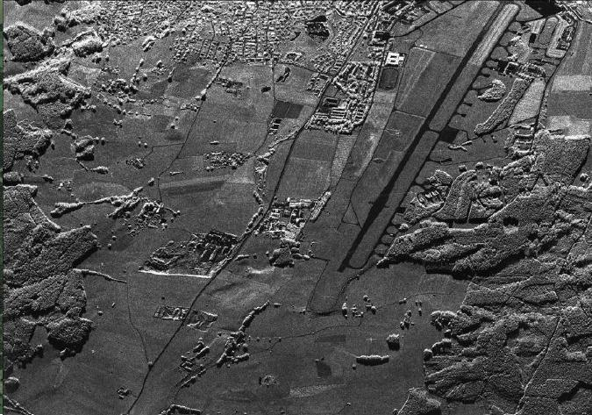
DTM Data Collection
Data collected from various sources
Spot Heights (xyz)
Stereo Images
Radar
Lidar

Slide 5
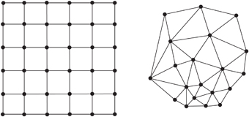
Approaches
Grid Structure
TIN (Triangulated Irregular Network)
Record elevation at each node
Interpolate smooth surface between grid points
Appears more natural
Redundant Data
Record X, Y, Z at surface point
Interpolate triangular surface between points
Unnatural representation of terrain

Slide 6
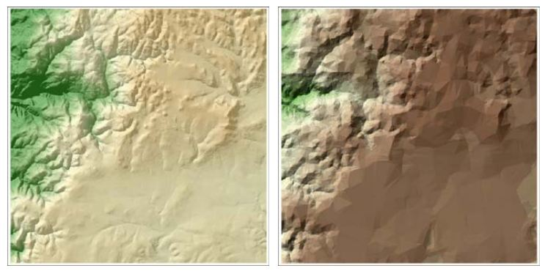
Grid vs TIN

Slide 7
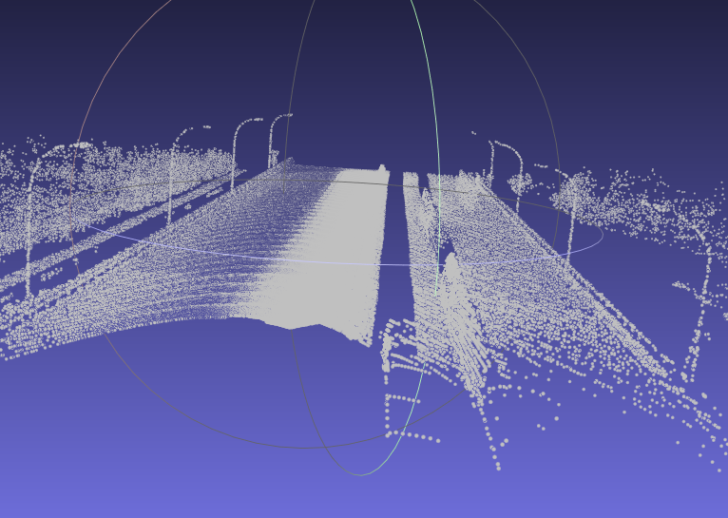
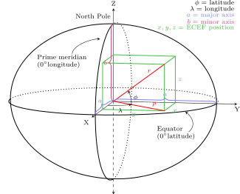
Preprocessing Point Cloud
.fuse – lon, lat, alt, intensity
Lla -> ECEF (Earth-centered, earth-fixed)
ECEF -> NED (North East Down)

Slide 8
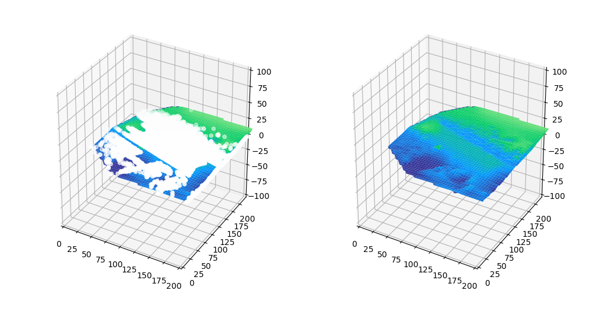
Results (grid)

Slide 9
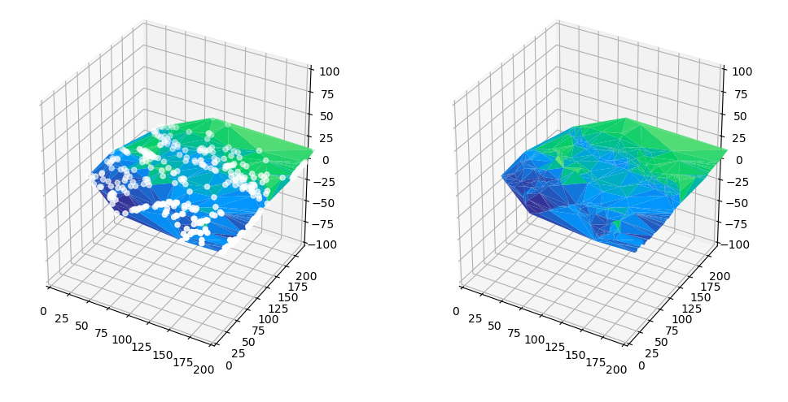
Results (TIN)

Slide 10
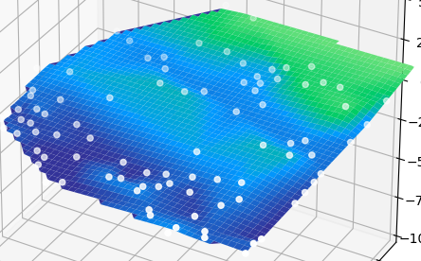
Finalized Method
Use the grid approach for querying points and collecting data
Filter data based on neighbors to limit space complexity of data structure
Natural render while preserving space

Slide 11
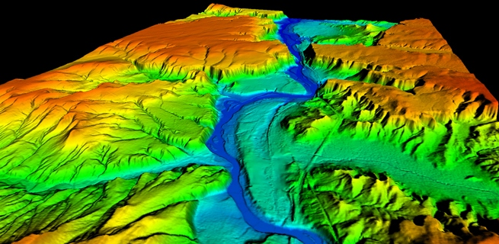
Future
More accurate conversion for local point cloud data
Better boundary definition and filtering method

Slide 12
Sources
Ma, Ruijin. "DEM generation and building detection from lidar data." Photogrammetric Engineering & Remote Sensing 71.7 (2005): 847-854.
Yunfei, Bao, et al. "Classification of LIDAR point cloud and generation of DTM from LIDAR height and intensity data in forested area." The International Archives of the Photogrammetry, Remote Sensing and Spatial Information Sciences 37.7 (2008): 313-318.
"NCGIA CCTP Unit 6." NCGIA CCTP Unit 6. N.p., n.d. Web. 07 Mar. 2017.

